Slide 1



Sentiment Analysis on Movie Reviews Using NLP
Analyzing customer feedback to drive business insights
https://github.com/RahulMorajker/final_project
Submitted by: Group E
Tolulope Abidoye- C0889074
Shwetha Thaithara Ajith - C0900978
Amal John - C0891512
Rahul Santosh- C0896330
Vinesh Suguru - C0896223
Abhishek Krishnan – C0909952

Slide 2

PROJECT OVERVIEW
In today’s digital age, everyone loves expressing their ideas online, especially about movies. Online reviews have transformed people’s choices of movies to watch. While unfavorable comments could discourage possible viewers, a positive review can help a movie be more popular.
Sentiment analysis helps a computer to identify whether a movie review is positive, negative, or neutral.
PROBLEM
Companies often struggle to understand customer sentiment from large volumes of reviews, leading to missed opportunities for improvement and engagement.
KEY GOAL
Use sentiment analysis model to automate review classification, help businesses gauge customer satisfaction and identify areas for improvement.

Slide 3

Main NLP Components
Data collection
IMDB movie reviews dataset 50,000 labelled reviews
Data processing
Cleaning: Remove HTML tags and punctuation
Tokenization
Normalization
Lemmatization
Lower Casing
Model Training
Intent Classification
Training with TF-IDF
Logistic Regression

Slide 4

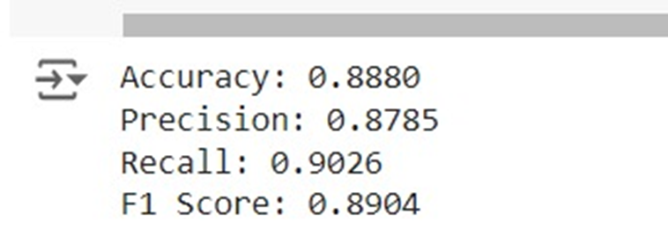

Insights
Results retrieved from the dataset
This Photo by Unknown Author is licensed under CC BY

Slide 5



Financial Viability
Using sentiment analysis saves money by automating feedback reviews, reducing the need for manual work. It also cuts costs by relying on cloud services instead of expensive equipment, making operations more efficient.
Cost Savings
The system can earn money through direct sales or licensing and by boosting other products. It can also generate revenue by offering consulting services based on the technology.
Revenue Generation
The system can handle more data and adapt to changing needs easily. This flexibility helps it enter new markets and stay relevant with updates, ensuring long-term competitiveness.
Scalability

Slide 6


Future Work
Multilingual Support: To improve the model's worldwide applicability, extend it to assess reviews in several languages using methods like translation or multilingual embeddings.
Real-Time Analysis: Create tools for sentiment analysis in real-time to keep an eye on and react to fresh reviews as they surface, which is helpful for social media and live feedback.
Investigate More Complex Models: By investigating more complex machine learning and deep learning models, sentiment analysis can be made even more accurate and comprehensive. More accurately than logistic regression, models like Long Short-Term Memory (LSTM), and Transformer-based architectures (e.g., BERT, GPT) can capture contextual information and complicated linguistic patterns. These models offer more reliable predictions and are capable of handling complex sentiment expressions.

Slide 7
Conclusion
The sentiment analysis model demonstrates the ability to classify movie reviews with high accuracy, providing a valuable tool for automating the understanding of customer sentiment. This project lays the foundation for further enhancements, such as exploring more advanced machine learning models, incorporating real-time analysis, and applying the model to other domains.

Slide 8

References
IMDb. (n.d.). IMDb Datasets. Retrieved from [https://www.imdb.com/interfaces/](https://www.imdb.com/interfaces/)
Maas, A. L., Daly, R. E., Pham, P. T., Huang, D., Ng, A. Y., & Potts, C. (2011).** Learning word vectors for sentiment analysis. *Proceedings of the 49th Annual Meeting of the Association for Computational Linguistics: Human Language Technologies*, 142-150. Retrieved from [https://www.aclweb.org/anthology/P11-1015](https://www.aclweb.org/anthology/P11-1015)
Pang, B., & Lee, L. (2008). Opinion mining and sentiment analysis. *Foundations and Trends in Information Retrieval, 2*(1–2), 1-135. doi:10.1561/1500000001
Scikit-learn. (n.d.). TfidfVectorizer. Retrieved from [https://scikit-learn.org/stable/modules/generated/sklearn.feature_extraction.text.TfidfVectorizer.html](https://scikit-learn.org/stable/modules/generated/sklearn.feature_extraction.text.TfidfVectorizer.html)
NLTK Project. (n.d.). NLTK Documentation. Retrieved from [https://www.nltk.org/](https://www.nltk.org/)

